Slide 1
IDS561 Big Data Analytics
Yuheng Hu
Assistant Professor@IDS

Slide 2
Hadoop recap
A reliable, scalable, and distributed architecture for large scale computation and data processing on a network of commodity hardware.
Handles thousands of nodes and petabytes of data
Hadoop subprojects:
MapReduce: A software framework for distributed processing of large data sets on computer clusters
HDFS: Hadoop Distributed File System with high throughput access to application data [Today’s topic]
and some others (e.g, HIVE, HBASE)…

Slide 3
Map-Reduce summary
Programmer specifies:
Map and Reduce and input files
Workflow:
Read inputs as a set of key-value-pairs
Map transforms input kv-pairs into a new set of k'v'-pairs
Sorts & Shuffles the k'v'-pairs to output nodes
All k’v’-pairs with a given k’ are sent to the same reduce
Reduce processes all k'v'-pairs grouped by key into new k''v''-pairs
Write the resulting pairs to files
All phases are distributed with many tasks doing the work
Input 0
Input 1
Input 2
Map 0
Map 1
Map 2
Shuffle
Reduce 0
Reduce 1
Out 0
Out 1

Slide 4

A quick recap of MapReduce
Facebook have lots of disk space and they serve hundreds of millions of requests everyday. They've decided to pre-compute calculations when they can to reduce the processing time of requests.
One common request on Facebook is the "You and Joe have 230 friends in common" feature.

Slide 5
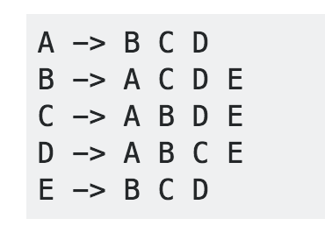
Task: use MapReduce so that we can calculate everyone's common friends once a day and store those results
Input:

Slide 6
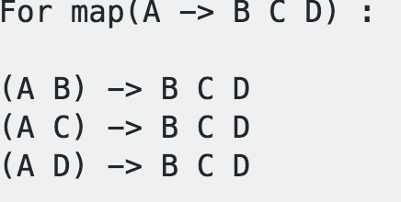
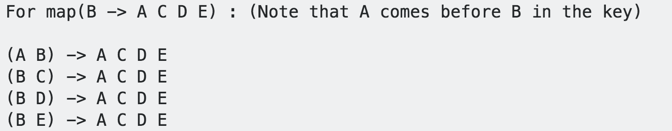
Map function
The key will be a friend along with the person. The value will be the list of friends.
The key will be sorted so that the friends are in order, causing all pairs of friends to go to the same reducer.

Slide 7
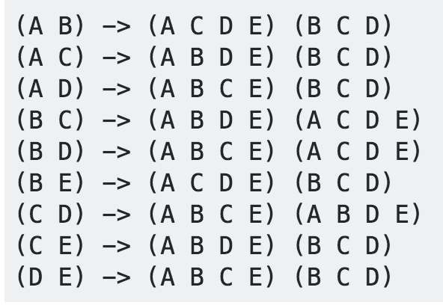
Reduce function
Sort and shuffle (taken care of by the service)
Each line will be passed as an argument to a reducer. The reduce function will simply intersect the lists of values and output the same key with the result of the intersection. For example, reduce((A B) -> (A C D E) (B C D)) will output (A B) : (C D) and means that friends A and B have C and D as common friends.

Slide 8
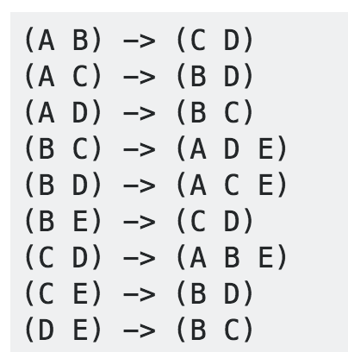
Results after Reduce function
when D visits B's profile, we can quickly look up (B D) and see that they have three friends in common, (A C E).

Slide 9
Schedule
Quick Recap of MapReduce
Head first HDFS
1st Lab
Hadoop installation

Slide 10
What do we actually want in big data analytics?
Requirements
Scales out with more data
Massively parallel
Cheaper than parallel databases
Able to run on cheap hardware!
Ability to use any processing tool
HDFS handles them
->MapReduce handles it

Slide 11
From Jeff Dean’s slides

Slide 12
HDFS
The Hadoop Distributed File System (HDFS) is a distributed file system designed to run on commodity hardware. It has many similarities with existing distributed file systems. However, the differences from other distributed file systems are significant.
highly fault-tolerant and is designed to be deployed on low-cost hardware.
provides high throughput access to application data and is suitable for applications that have large data sets.

Slide 13
Hadoop’s Architecture (HDFS)
NameNode:
Stores metadata for the files, like the directory structure of a typical FS.
The server holding the NameNode instance is quite crucial, as there is only one.
Transaction log for file deletes/adds, etc. Does not use transactions for whole blocks or file-streams, only metadata.
Handles creation of more replica blocks when necessary after a DataNode failure

Slide 14
Hadoop’s Architecture (HDFS)
DataNode :
Stores the actual data in HDFS
Can run on any underlying filesystem (ext3/4, NTFS, etc)
Notifies NameNode of what blocks it has
NameNode replicates blocks 2-3x in local rack, 1x elsewhere

Slide 15
Hadoop’s Architecture (HDFS)
HDFS is a Master-Slave architecture
Master: namenodeSlave: datanode (100s or 1000s of nodes)
Single namenode and many datanodes
Namenode maintains the file system metadata
Files are split into fixed sized blocks and stored on data nodes (Default 64MB)
Data blocks are replicated for fault tolerance and fast access (Default is 3)

Slide 16

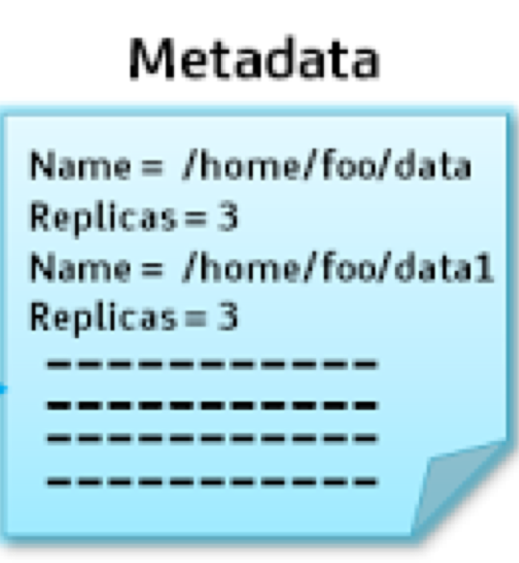
Hadoop’s Architecture (HDFS)
Metadata ops
NameNode
Data block
Block ops
DataNode
DataNode
Replication
Rack 1
Rack 2

Slide 17
Keep things reliable
Reliable distributed file system
Data kept in “slave” spread across machines
Each slave/chunk replicated on different machines
Seamless recovery from disk or machine failure

Slide 18
Rack Awareness
NameNode ensures that all the replicas are not stored on the same rack or a single rack. It follows an in-built Rack Awareness Algorithm to reduce latency as well as provide fault tolerance.
Considering the replication factor is 3, the Rack Awareness Algorithm says that the first replica of a block will be stored on a local rack and the next two replicas will be stored on a different (remote) rack but, on a different DataNode within that (remote) rack as shown in the figure above.

Slide 19
Can Name Node and Data Node on the same machine?
Yes or No?
Not recommended, DataNode may get full and NameNode may start having issues and in turn bring the whole cluster down!

Slide 20
Hadoop’s Architecture (HDFS)
MapReduce Engine:
JobTracker & TaskTracker
JobTracker splits up data into smaller tasks(“Map”) and sends it to the TaskTracker process in each node
TaskTracker reports back to the JobTracker node and reports on job progress, sends data (“Reduce”) or requests new jobs

Slide 21
Putting everything together…
namenode
job submission node
namenode daemon
jobtracker
tasktracker
tasktracker
tasktracker
datanode daemon
datanode daemon
datanode daemon
Linux file system
Linux file system
Linux file system
…
…
…
slave node
slave node
slave node
One of each:
Namenode (NN): master node for HDFS
Jobtracker (JT): master node for job submission
Set of each per slave machine:
Tasktracker (TT): contains multiple task slots
Datanode (DN): serves HDFS data blocks

Slide 22
So, how do MapReduce & HDFS work together?
Job – A “full program” - an execution of a Mapper and Reducer across a data set
Task – An execution of a Mapper or a Reducer on a slice of data
a.k.a. Task-In-Progress (TIP)
Task Attempt – A particular instance of an attempt to execute a task on a machine
Some MapReduce Terminology

Slide 23
Anatomy of a Job
MapReduce program in Hadoop = Hadoop job
Jobs are divided into map and reduce tasks
An instance of running a task is called a task attempt (occupies a slot)
Multiple jobs can be composed into a workflow
Job submission:
Client (i.e., driver program) creates a job, configures it, and submits it to jobtracker
That’s it! The Hadoop cluster takes over…

Slide 24
Anatomy of a Job
Behind the scenes:
Input splits are computed (on client end)
Job data (jar, configuration XML) are sent to JobTracker
JobTracker puts job data in shared location, enqueues tasks
TaskTrackers poll for tasks
Off to the races…

Slide 25
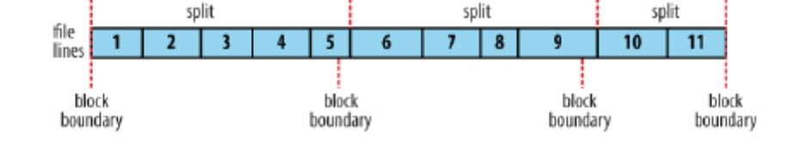
Hadoop Job Execution (Conceptual)
Divide input into fixed-sized input splits • Typical split size is 1 HDFS block (64 MB or 128 MB)
Run a map task for each split
Map tasks run in parallel
Preference is given to running map on node where split is locally stored
Map tasks write their output to local hard drive
Sort map output and send to reduce task (shuffle)
All records for the same key are sent to the same reducer
By default, keys are partition between reducers using a hash function
Merge records on reducer from multiple mappers
Run reduce task
Write output to HDFS

Slide 26
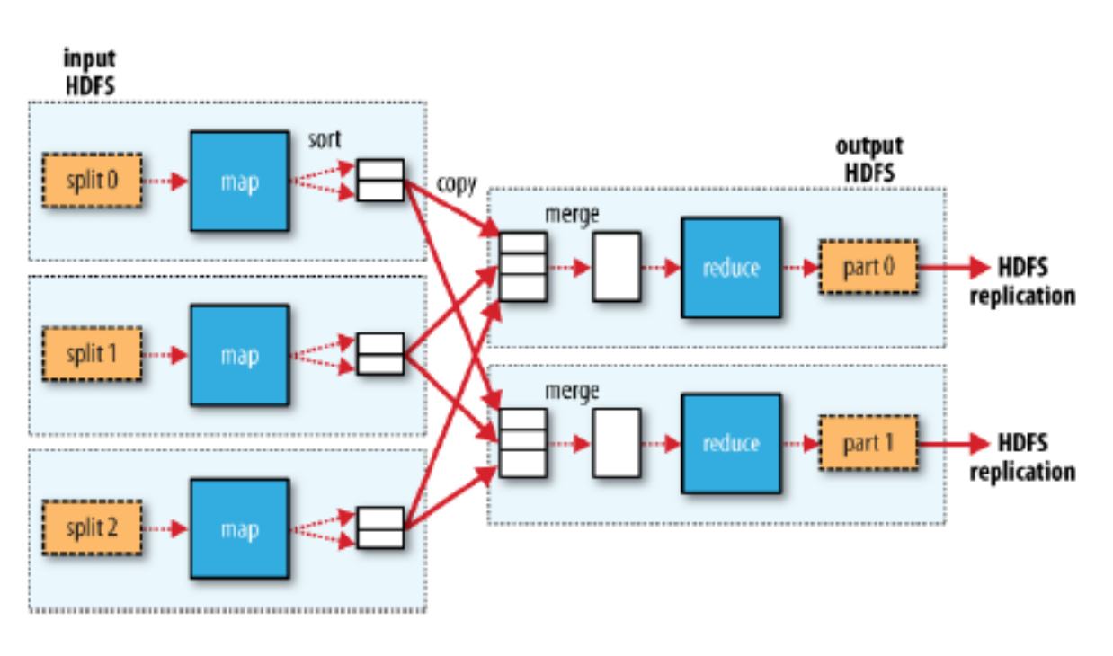
Hadoop Job Execution (Conceptual)

Slide 27
How Does Hadoop work in practice?

Slide 28
How Does Hadoop work in practice?
Workers are assigned jobs by the master
The master is started by the MapReduce Framework

Slide 29
Execution
Workers assigned map tasks read the input, parse it and invoke
the user’s Map() method.

Slide 30
Execution
Intermediate key/value pairs are buffered in memory
Periodically, buffered data is written to local disk (R files)
Pseudo random partitioning function (e.g., (hash(k) mod R)

Slide 31
Execution
Locations are passed back to the master who forwards these
locations to workers executing the reduce function.

Slide 32
Execution
Reduce runs after all mappers are done
Workers executing Reduce are notified by the master about
location of intermediate data

Slide 33
Execution
Reduce workers use remote procedure calls to read the data from
local disks of map works
Sorts all intermediate data by intermediate key

Slide 34
Execution
Reduce worker iterates over the sorted intermediate data and for
each key encountered it passes the key and the corresponding set
of intermediate values to the Reduce function

Slide 35
Execution
The output of the Reduce function is appended to a final output
file

Slide 36
Client
Records
…
…
InputSplit
InputSplit
InputSplit
RecordReader
RecordReader
RecordReader
Mapper
Mapper
Mapper

Slide 37
Mapper
Mapper
Mapper
Mapper
Mapper
Intermediates
Intermediates
Intermediates
Intermediates
Intermediates
Partitioner
Partitioner
Partitioner
Partitioner
Partitioner
(combiners omitted here)
Intermediates
Intermediates
Intermediates
Reducer
Reducer
Reduce
Source: redrawn from a slide by Cloduera, cc-licensed

Slide 38
Reducer
Reducer
Reduce
OutputFormat
RecordWriter
RecordWriter
RecordWriter
Output File
Output File
Output File
Source: redrawn from a slide by Cloduera, cc-licensed

Slide 39
Input and Output
InputFormat:
TextInputFormat
KeyValueTextInputFormat
SequenceFileInputFormat
…
OutputFormat:
TextOutputFormat
SequenceFileOutputFormat
…

Slide 40

Hadoop Workflow
1. Load data into HDFS
2. Develop code locally
3. Submit MapReduce job
3a. Go back to Step 2
Hadoop Cluster
You
4. Retrieve data from HDFS

Slide 41
Recommended Workflow
Here’s how I work:
Develop code in Eclipse on host machine
Build distribution on host machine
Check out copy of code on VM
Copy (i.e., scp) jars over to VM (in same directory structure)
Run job on VM
Iterate
…
Commit code on host machine and push
Pull from inside VM, verify
Avoid using the UI of the VM
Directly ssh into the VM

Slide 42
MapReduce-Fault tolerance
Slave(worker) failure: The master pings every worker periodically. If no response is received from a worker in a certain amount of time, the master marks the worker as failed. Any map tasks completed by the worker are reset back to their initial idle state, and therefore become eligible for scheduling on other workers. Similarly, any map task or reduce task in progress on a failed worker is also reset to idle and becomes eligible for rescheduling.
Master Failure: It is easy to make the master write periodic checkpoints of the master data structures described above. If the master task dies, a new copy can be started from the last checkpointed state. However, in most cases, the user restarts the job.

Slide 43
Lab session next…
Install MapReduce

